Slide 1
LLMs from zero to hero
Build using open source
Notes:
Greet
Introduce yourself and Maciej
Introduce the topic

Slide 2

Notes:
It all started with the 2 of us , playing around with image generators
Ask about MidJourney
Maybe we have open source lovers here, so should ask about Stable diffusion

Slide 3


Slide 4
Large language models
Notes:
LLM refers to models that use deep learning techniques to capture complex patterns to produce text. They usually trained using self-supervised learning.
They are beyond the scene of a large transformer model, which is too massive to run on a single machine. LLMs are often provided as an API or web interface.

Slide 5
Large language models
Notes:
are trained on huge data sets with many parameters.
Generative Pre-trained Transformer version 3 (GPT-3) has more than 175 billion parameters and was trained on about 45 TB of text. This is how they can have such broad applicability.

Slide 6
Large language models
Notes:
that they operate primarily on human language.

Slide 7
Large language models
Notes:
they are used to find patterns or make predictions within data.

Slide 8
Who needs LLMs?Software testing
Media
Software testing
Financial services
Automotive
Hospitality
Real estate
Retail
Food economy
Telco
Meteorology
Healthcare
Logistics
Oil & Gas
Notes:
As LLMs have grown in size, so have their capabilities.
Broadly, LLM use cases for text-based content can be divided up in the following manner:
Generation (e.g., story writing, marketing content creation)
Summarization (e.g., legal paraphrasing, meeting notes summarization)
Translation (e.g., between languages, text-to-code)
Classification (e.g., toxicity classification, sentiment analysis)
Chatbot (e.g., open-domain Q+A, virtual assistants)

Slide 9
LLMs vs traditional ML
Artificial intelligence
NLP
ML
Rule based LLMs
ML based LM, LLMs
Notes:
LLMs are specialised in natural language processing, not designed for handling structured data, clustering, image analysis, or ranking structured data tasks, where other machine learning models and algorithms like linear regression, logistic regression, or convolutional neural networks (CNNs) would be more appropriate
Choice depends on the use case
However, LLMs bring some benefits
Improved Performance: LLMs have shown significant improvements in performance across a wide range of NLP tasks, often surpassing previous state-of-the-art models and sometimes approaching human-level performance.
Few-shot Learning: LLMs can demonstrate an ability to learn new tasks with limited or no additional training by leveraging the vast knowledge captured during pretraining.
Multitask and Multilingual Capabilities: LLMs can handle multiple tasks simultaneously and support multiple languages, making them more versatile and adaptable to various use cases.

Slide 10
Can we do it?
Training is resource heavy

Slide 11
Can we do it?
Training is resource heavy
Distributed training, GPU sharing, fine tuning and p-tuning

Slide 12
Can we do it?
Training is resource heavy
Distributed training, GPU sharing, fine tuning and p-tuning
Costs are high

Slide 13
Can we do it?
Training is resource heavy
Distributed training, GPU sharing, fine tuning and p-tuning
Costs are high
Open source, automation, hybrid-cloud

Slide 14
Can we do it?
Training is resource heavy
Distributed training, GPU sharing, fine tuning and p-tuning
Costs are high
Open source, automation, hybrid-cloud
It is not reproducible

Slide 15
Can we do it?
Training is resource heavy
Distributed training, GPU sharing, fine tuning and p-tuning
Costs are high
Open source, automation, hybrid-cloud
It is not reproducible
MLOps pipelines, Kubeflow, MLflow

Slide 16
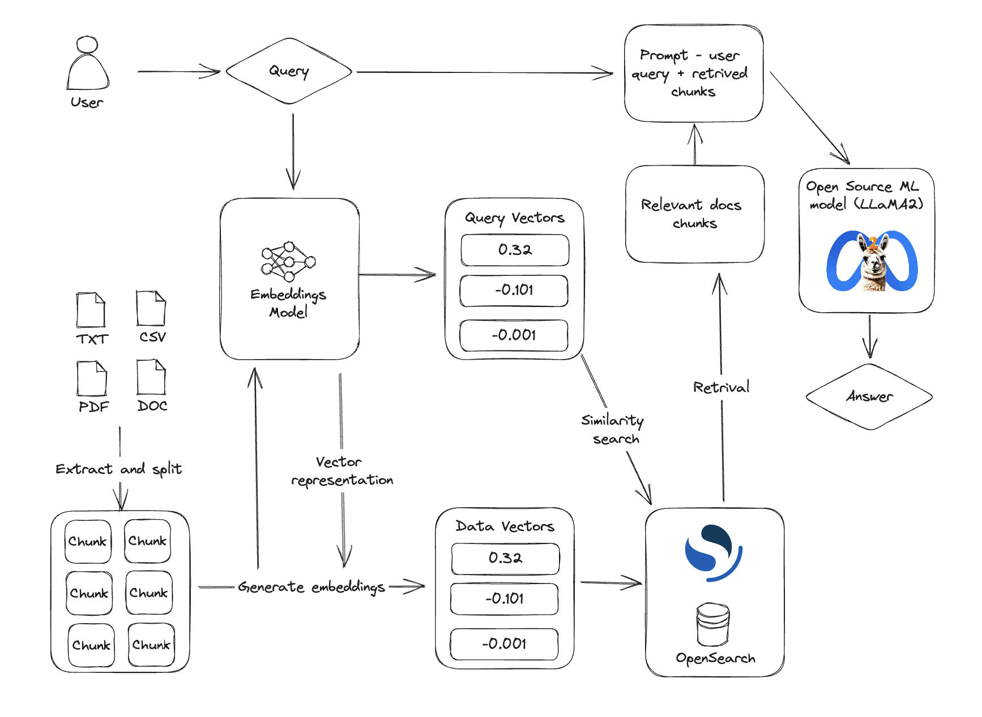
Basic architecture

Slide 17
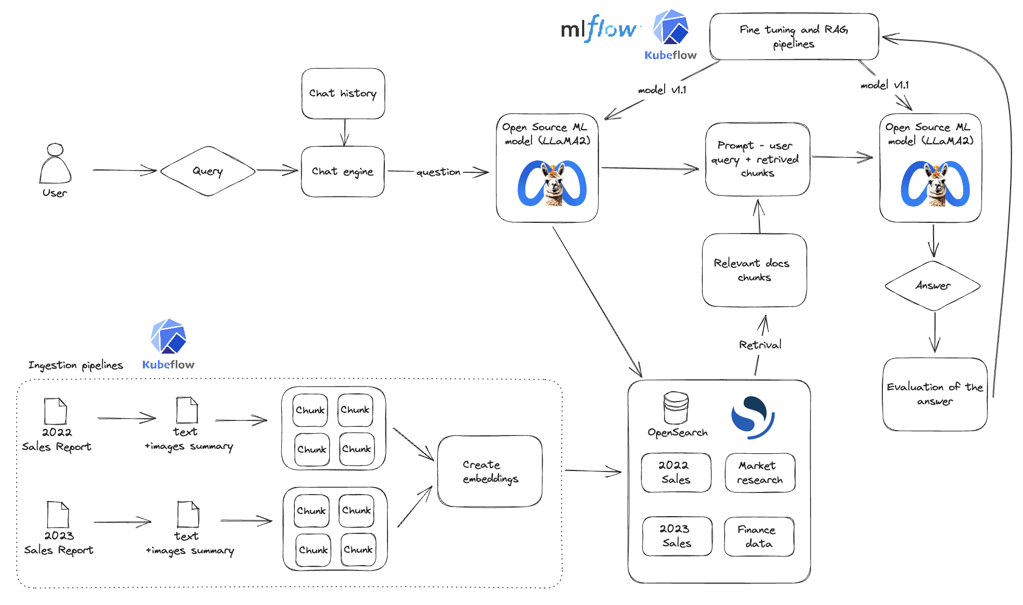
Real world example
Notes:
Faithfulness: measure if the response from a query engine matches any source nodes.
Relevancy: measure if the response and source nodes match the query.
Guideline: evaluate a question-answer system given user-specified guidelines.
Correctness: assess the relevance and correctness of a generated answer against a reference answer.
Embedding similarity: evaluate the quality of a question-answer system via semantic similarity.
Integration with DeepEval: unit test your LLMs with DeepEval and LlamaIndex integration.
Question Generation: use DatasetGenerator to generate a list of questions that could be asked about your data.
BatchEvalRunner: run a series of evaluations asynchronously.
Retrieval Eval: evaluate the quality of any Retriever module.

Slide 18

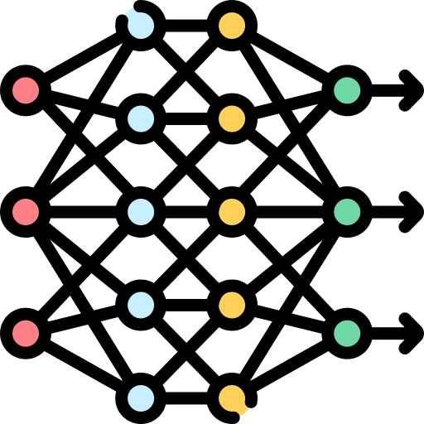

LLMs projects with open source
Models
Tools
Frameworks

Slide 19
LLMs projects with open source
👍 | 👎
Easy to get started | Security and privacy concerns
Cost-efficiency | Lack of support
Customisation | Stepper learning curve
Community support | Documentation
Ability to contribute | Bug fixing can take longer

Slide 20
To wrap it up…
Get started with a use case
Open source
Reproduce experiments
Runs on any environment
Enterprise support
Scale with integrated solutions
Notes:
Where to start
Have a problem to begin with, a use cases that you believe in
Look for open source alternatives to help you out. Maciej alreayd presented you an architecture, so using tools such as… and models such as …. could help
Large language models, exactly like AI in general, is here to stay. Having 0 skills now is no problem, the world gives you enough resources to become tomorrow’s hero.

Slide 21


Innovate at speed with open source AI
Andreea Munteanu
AI Product Manager
Maciej Mazur
AI Director
Booth A24!
Notes:
Aspire to universal enterprise platform
Procurement as a driver of company-wide policy
Give examples of security, compliance and support

Slide 22
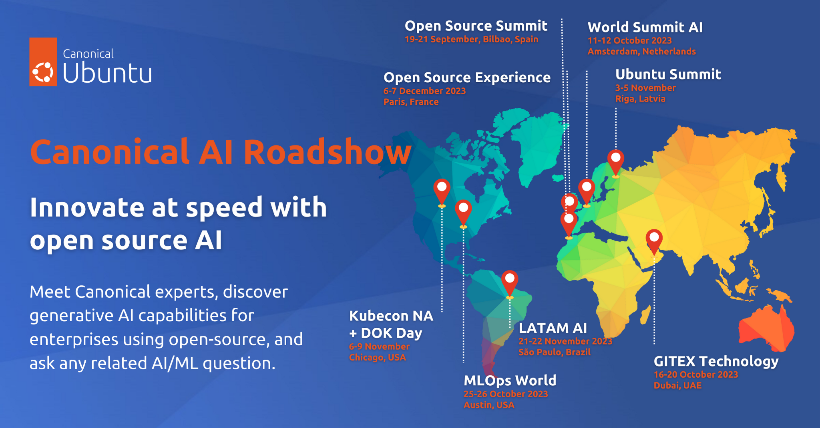


Innovate at
speed with
open source AI
Canonical AI Roadshow
World Summit AI
11-12 October 2023 - Amsterdam, Netherlands
GITEX Technology
16-20 October 2023 - Dubai, UAE
MLOps World
25-26 October 2023 - Austin, USA
Ubuntu Summit
3-5 November - Riga, Latvia
Kubecon NA + DOK Day
6-9 November - Chicago, USA
LATAM AI
21-22 November 2023 - São Paulo, Brazil
Open Source Experience
6-7 December 2023 - Paris, France
From generative AI to predictive analytics, deliver your AI projects to production with open source tooling
https://ubuntu.com/ai/roadshow

